Slide 1
OMS Logical

Slide 2
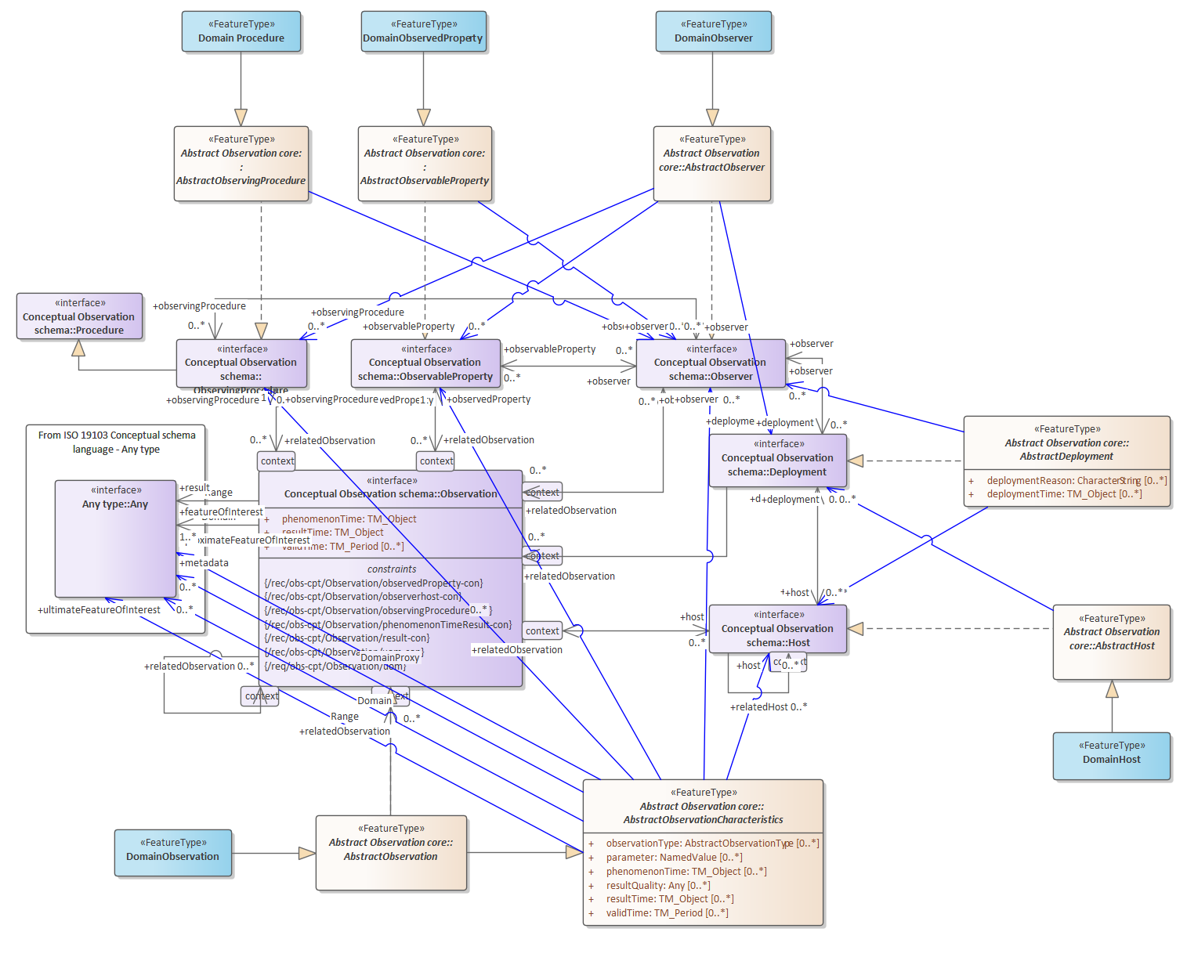
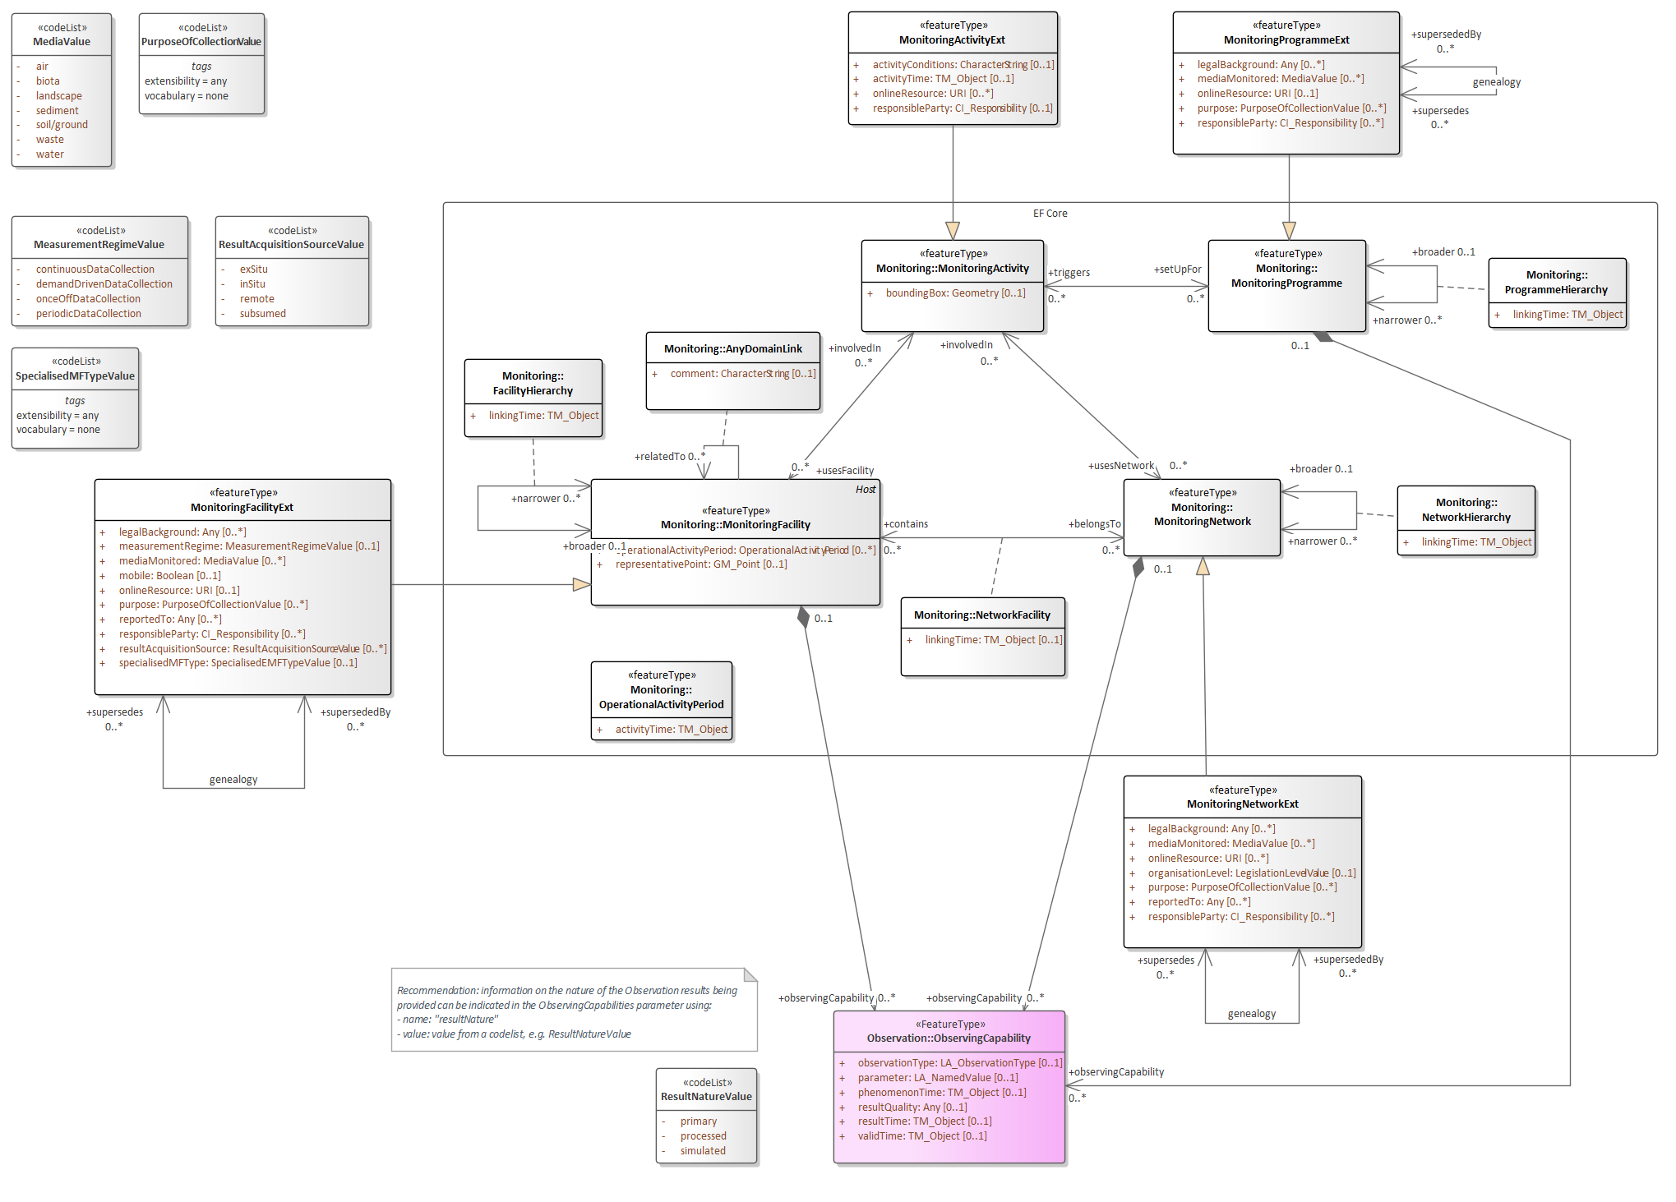
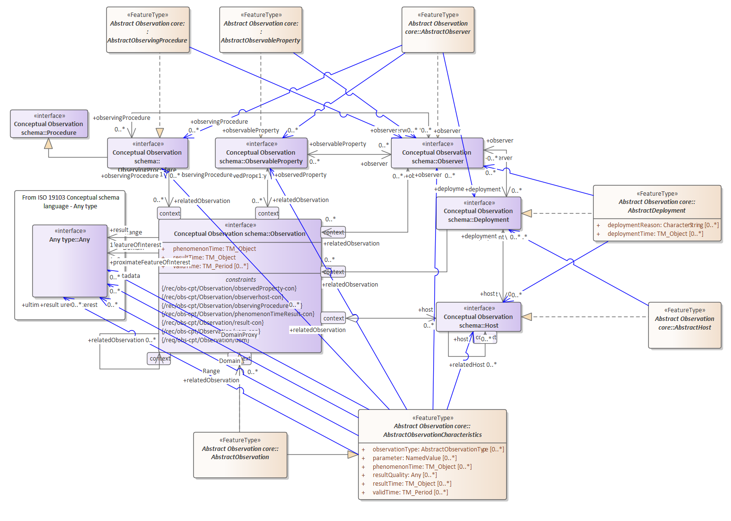
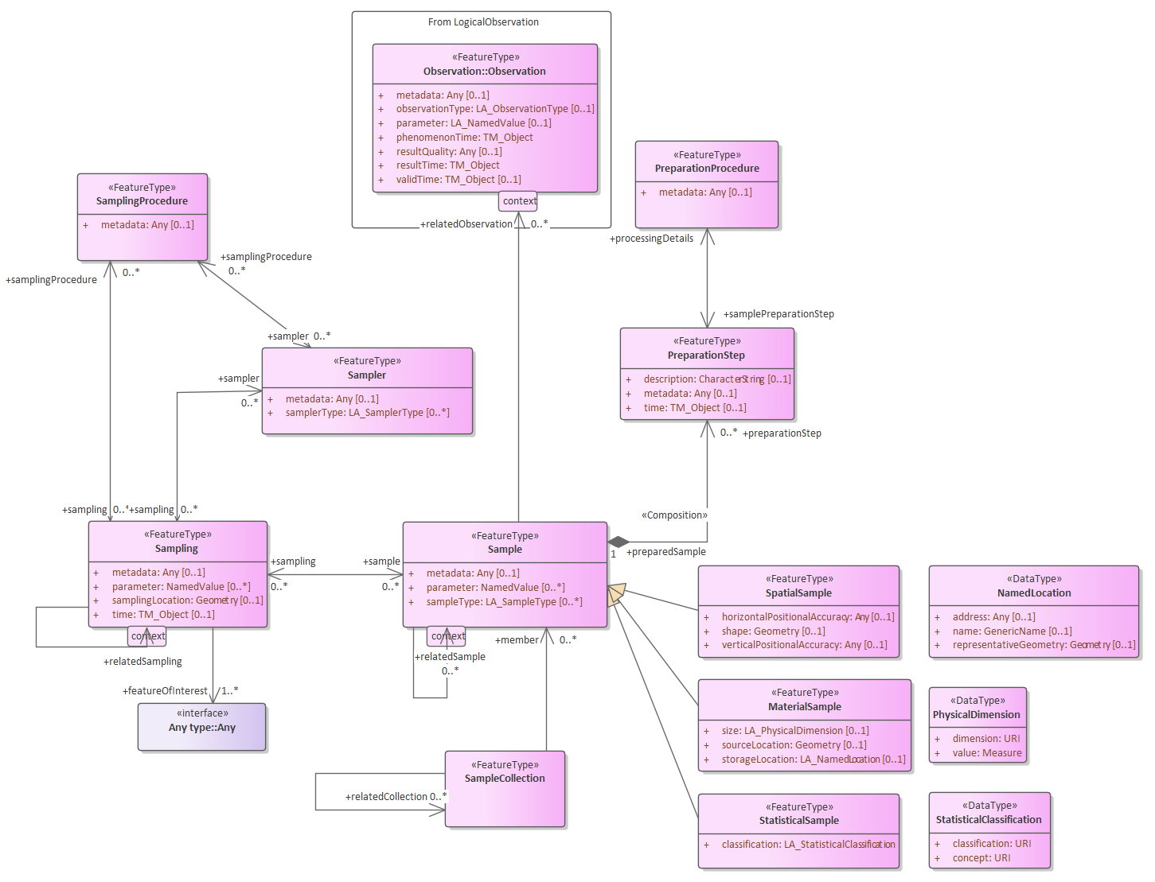
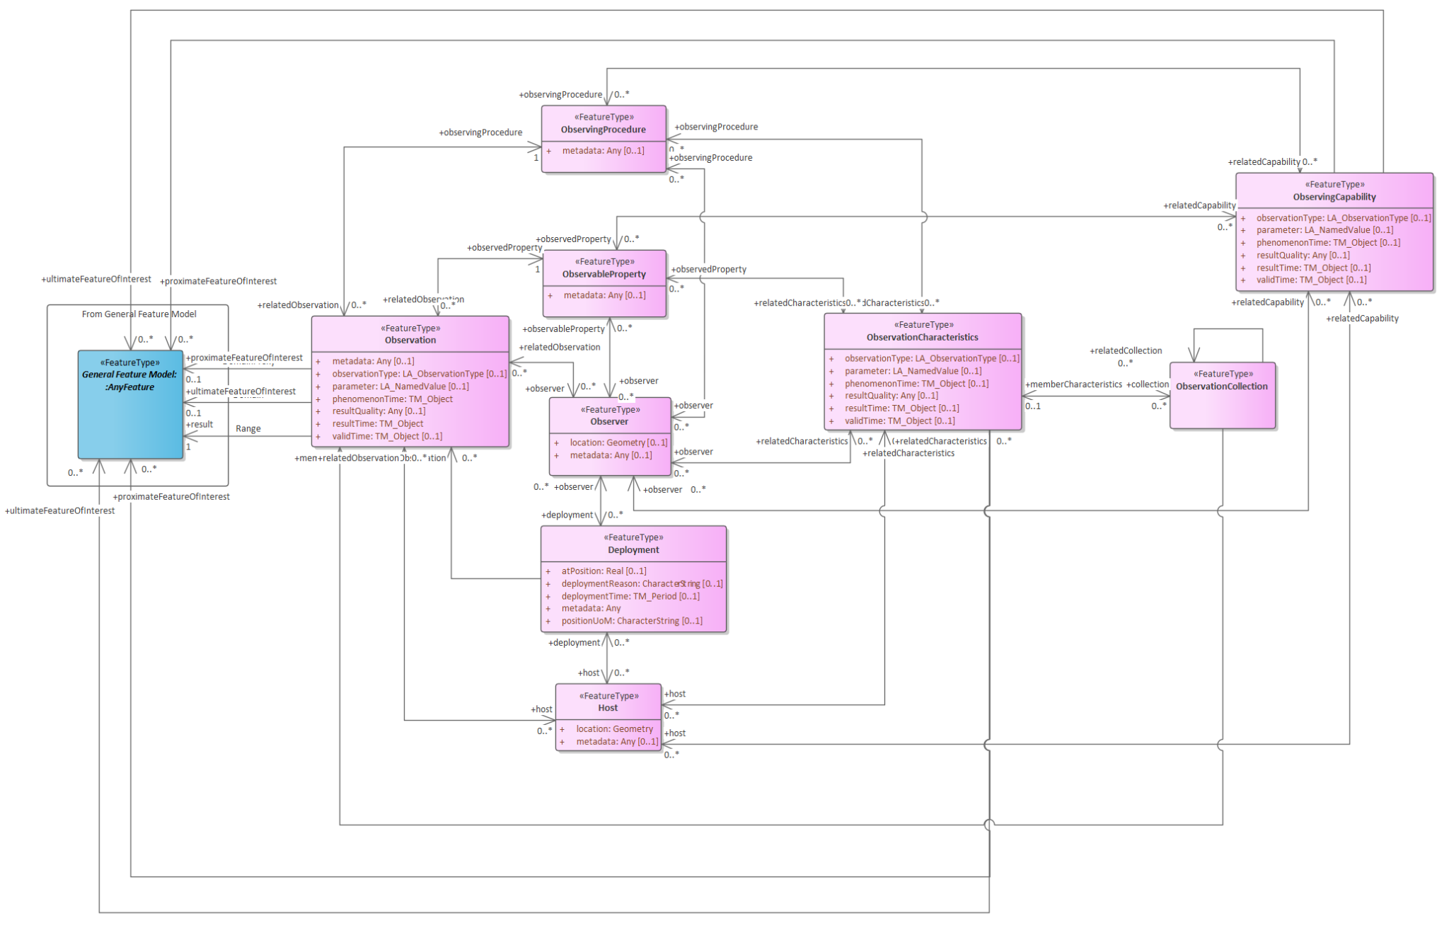
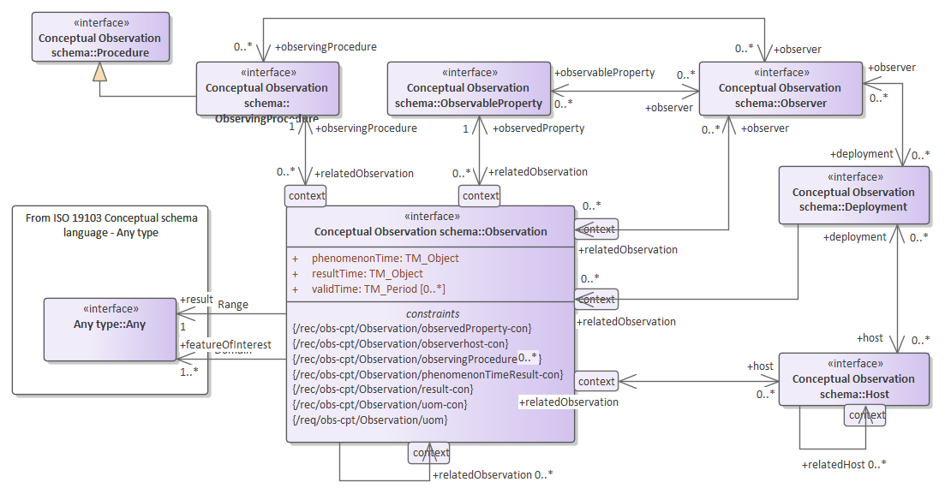
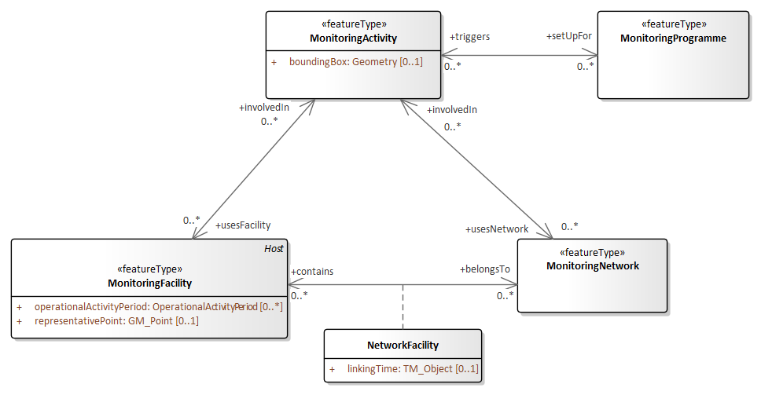
OMS Logical
Modelling with full OMS model complex due to associations between model tiers.
OMS Logical provides a flattened version of OMS, all associations at this level:
Observation
Sampling
Monitoring (Abstracted from INSPIRE Environmental Monitoring Facilities)
Extended Monitoring (all attributes optional)

Slide 3
OMS Logical
OMS Logical Draft available from Pending and OMS GitHub
1:1 implementation of OMS
Document Structure:
Scope: relation to OMS
Conformance: Boilerplate
References: from OMS
Terms and Definitions: from OMS
Conventions: Boilerplate
Applying this model (informative): what it says
Fundamental characteristics of observations and samples (informative): mostly notes and examples from OMS
- 11. Models: Observation, Sampling, Monitoring, Monitoring Extended
ATS (while seemingly superficial, a 1:1 copy from OMS!)
Foundation for current TSML update (as well as other OMS based standards, e.g. WaterML 2.0, GeoSciML, GloSIS, etc.)

Slide 4

THANK YOU
www.ogc.org

